Slide 1


Slide 2
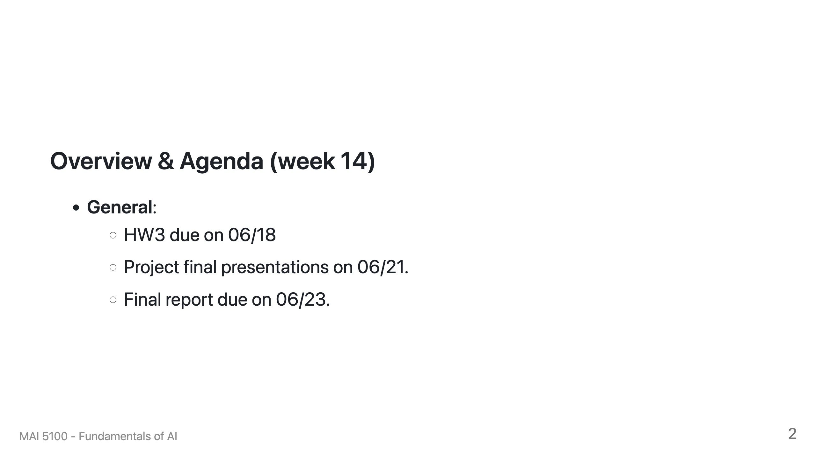

Slide 3
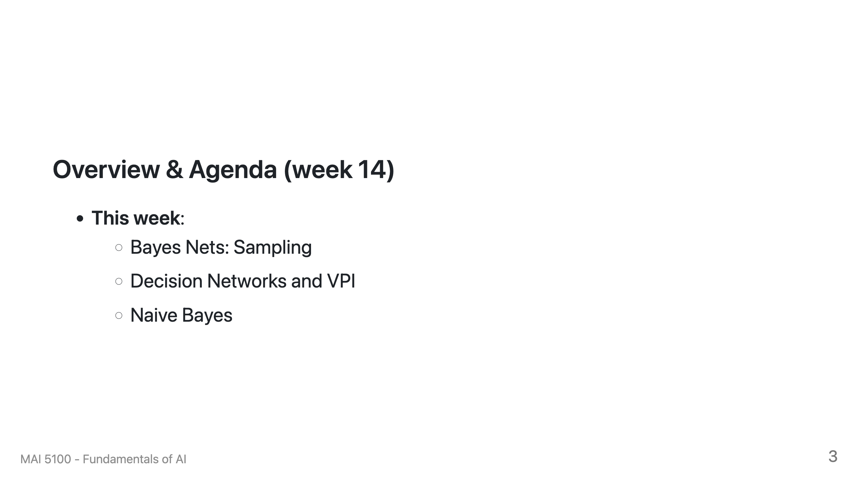

Slide 4
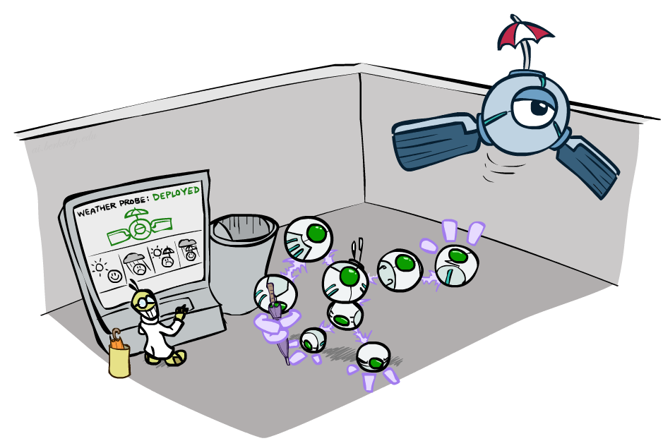
Decision Networks and Value of Perfect Information
Notes:
Please retain proper attribution, including the reference to ai.berkeley.edu. Thanks!

Slide 5
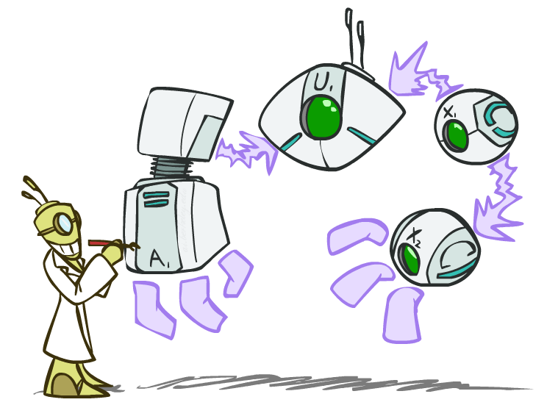
Decision Networks

Slide 6
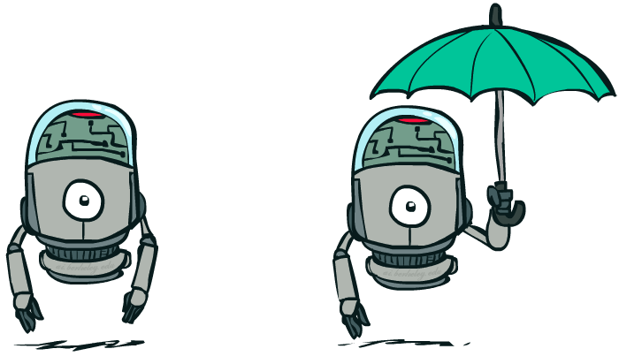
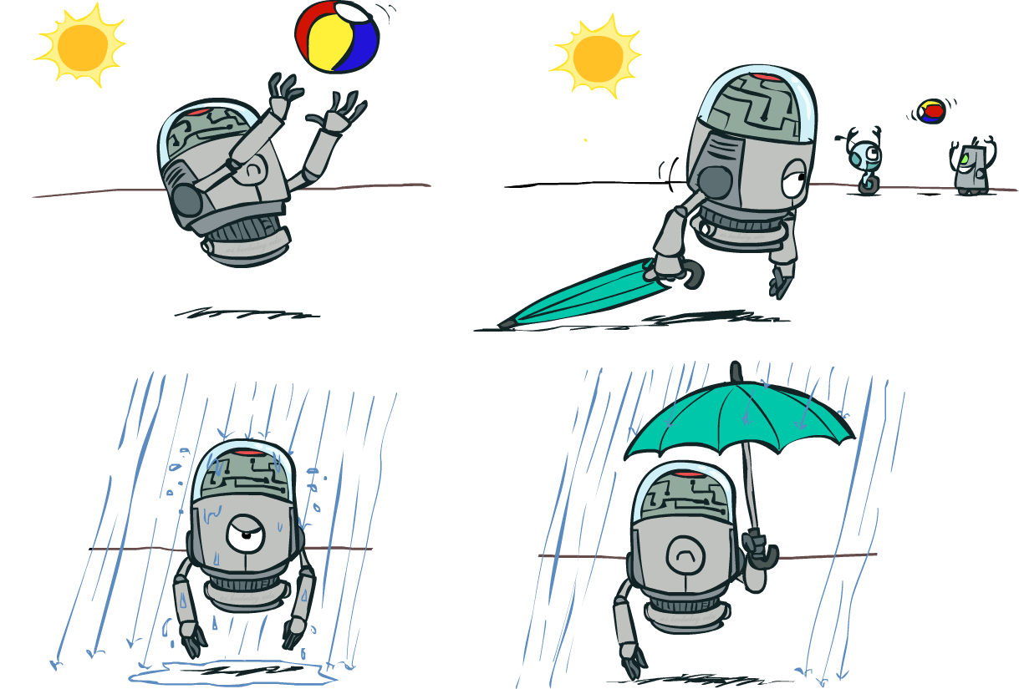
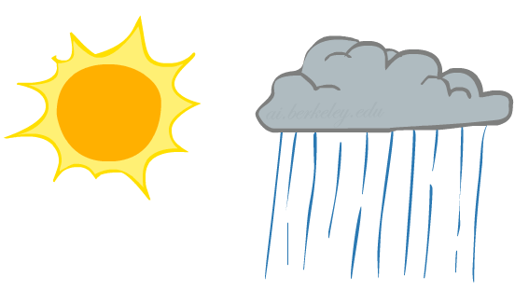
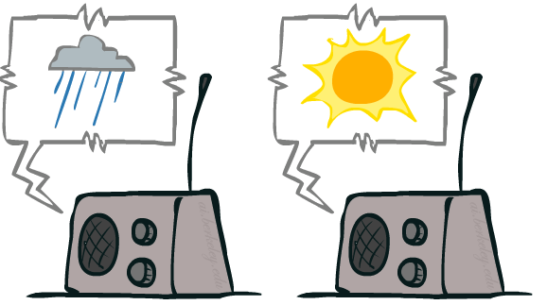
Decision Networks
Umbrella
U
Weather
Forecast
Notes:
There exists a ghostbusters demo

Slide 7
Decision Networks
MEU: choose the action which maximizes the expected utility given the evidence
Can directly operationalize this with decision networks
Bayes nets with nodes for utility and actions
Lets us calculate the expected utility for each action
New node types:
Chance nodes (just like BNs)
Actions (rectangles, cannot have parents, act as observed evidence)
Utility node (diamond, depends on action and chance nodes)
Umbrella
U
Weather
Forecast
Notes:
There exists a ghostbusters demo

Slide 8
Decision Networks
Action selection
Instantiate all evidence
Set action node(s) each possible way
Calculate posterior for all parents of utility node, given the evidence
Calculate expected utility for each action
Choose maximizing action
Umbrella
U
Weather
Forecast
Notes:
There exists a ghostbusters demo

Slide 9
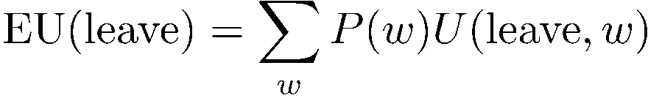
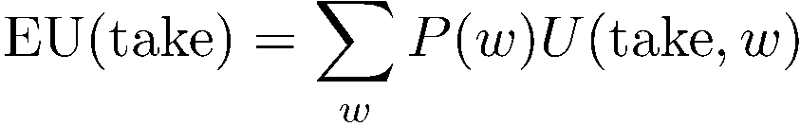
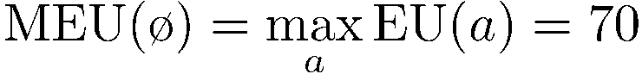
Decision Networks
Umbrella = leave
Umbrella
U
Umbrella = take
Weather
A | W | U(A,W)
leave | sun | 100
leave | rain | 0
take | sun | 20
take | rain | 70
W | P(W)
sun | 0.7
rain | 0.3
Optimal decision = leave
Notes:
There exists a ghostbusters demo

Slide 10
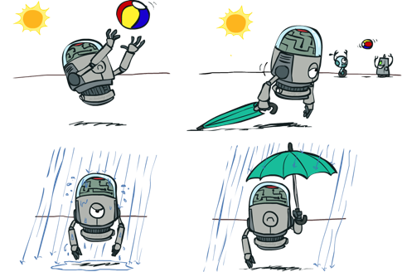

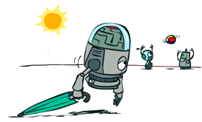

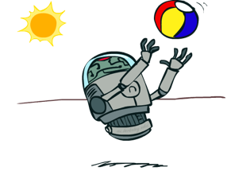
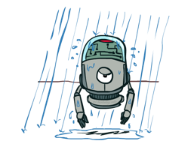
Decisions as Outcome Trees
{}
take
leave
Umbrella
Weather | {}
Weather | {}
U
sun
sun
Weather
rain
rain
U(t,s)
U(t,r)
U(l,s)
U(l,r)
Almost exactly like expectimax / MDPs
What’s changed?

Slide 11
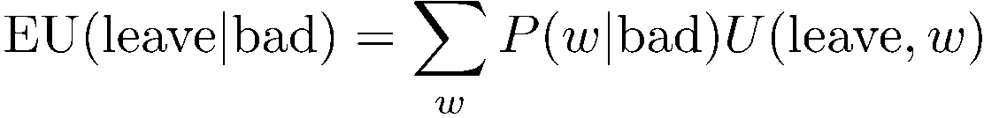

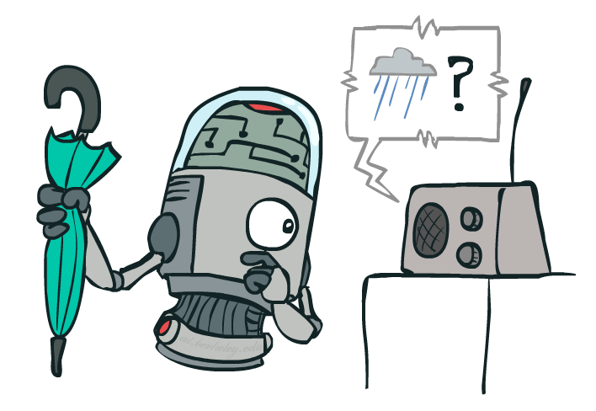
Example: Decision Networks
Umbrella = leave
A | W | U(A,W)
leave | sun | 100
leave | rain | 0
take | sun | 20
take | rain | 70
Umbrella
U
Umbrella = take
Weather
W | P(W|F=bad)
sun | 0.34
rain | 0.66
Optimal decision = take
Forecast
=bad

Slide 12
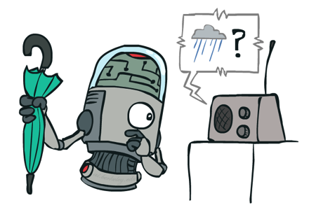
Decisions as Outcome Trees
Umbrella
{b}
take
leave
U
W | {b}
W | {b}
Weather
sun
sun
rain
rain
U(t,s)
U(t,r)
U(l,s)
U(l,r)
Forecast
=bad

Slide 13
Ghostbusters Decision Network
Demo: Ghostbusters with probability
Bust
U
Ghost Location
…
Sensor (1,1)
Sensor (1,2)
Sensor (1,3)
Sensor (1,n)
Sensor (2,1)
…
…
…
Sensor (m,1)
Sensor (m,n)

Slide 14
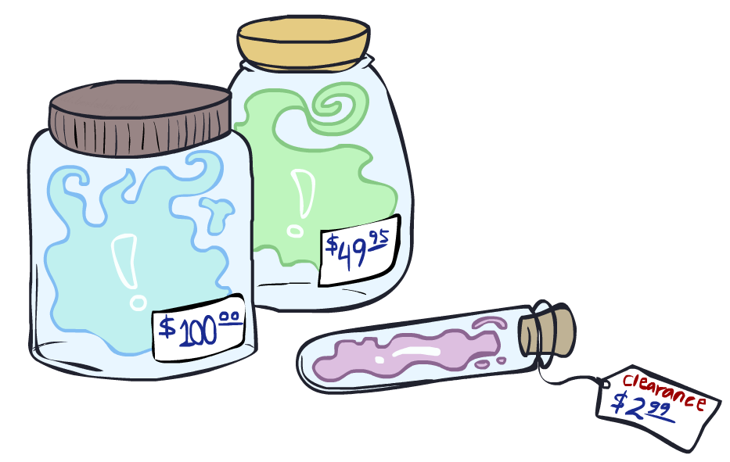
Value of Information

Slide 15
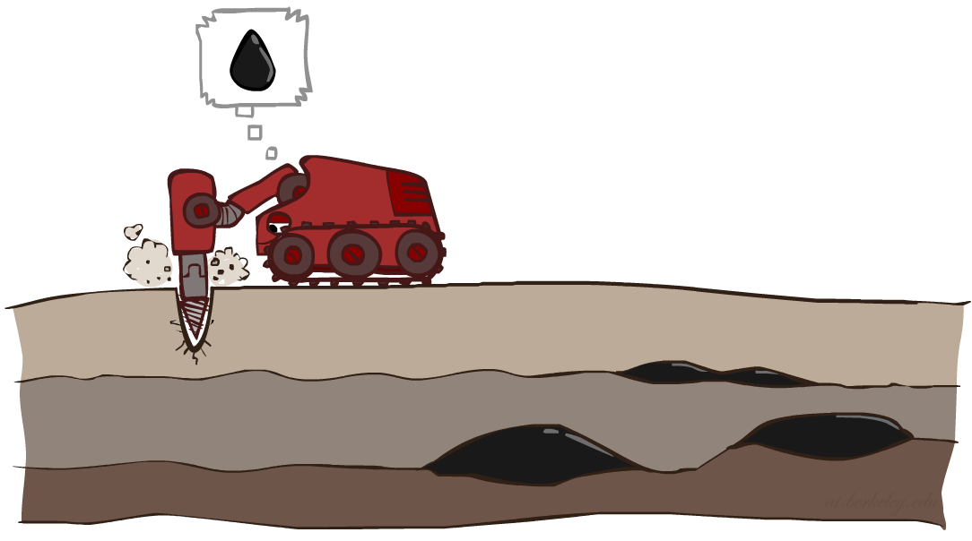
Value of Information
Idea: compute value of acquiring evidence
Can be done directly from decision network
Example: buying oil drilling rights
Two blocks A and B, exactly one has oil, worth k
You can drill in one location
Prior probabilities 0.5 each, & mutually exclusive
Drilling in either A or B has EU = k/2, MEU = k/2
Question: what’s the value of information of O?
Value of knowing which of A or B has oil
Value is expected gain in MEU from new info
Survey may say “oil in a” or “oil in b,” prob 0.5 each
If we know OilLoc, MEU is k (either way)
Gain in MEU from knowing OilLoc?
VPI(OilLoc) = k/2
Fair price of information: k/2
D | O | U
a | a | k
a | b | 0
b | a | 0
b | b | k
DrillLoc
U
O | P
a | 1/2
b | 1/2
OilLoc

Slide 16
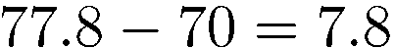
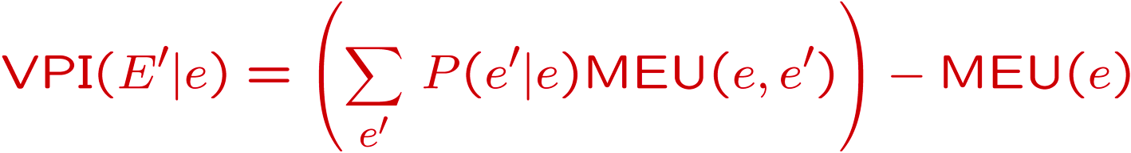
VPI Example: Weather
MEU with no evidence
Umbrella
A | W | U
leave | sun | 100
leave | rain | 0
take | sun | 20
take | rain | 70
U
MEU if forecast is bad
Weather
MEU if forecast is good
Forecast
Forecast distribution
F | P(F)
good | 0.59
bad | 0.41

Slide 17
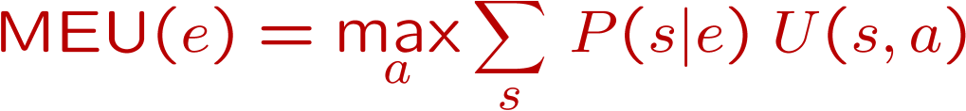
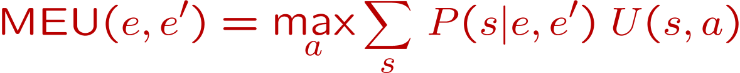
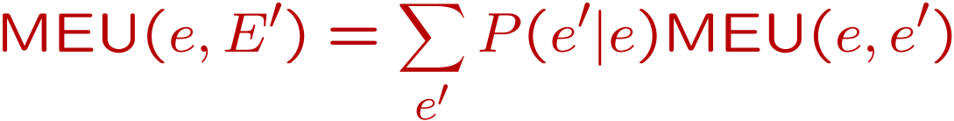
Value of Information
{+e}
Assume we have evidence E=e. Value if we act now:
Assume we see that E’ = e’. Value if we act then:
BUT E’ is a random variable whose value is
unknown, so we don’t know what e’ will be
Expected value if E’ is revealed and then we act:
Value of information: how much MEU goes up
by revealing E’ first then acting, over acting now:
a
P(s | +e)
U
{+e, +e’}
a
P(s | +e, +e’)
U
{+e}
P(+e’ | +e)
P(-e’ | +e)
{+e, +e’}
{+e, -e’}
a

Slide 18
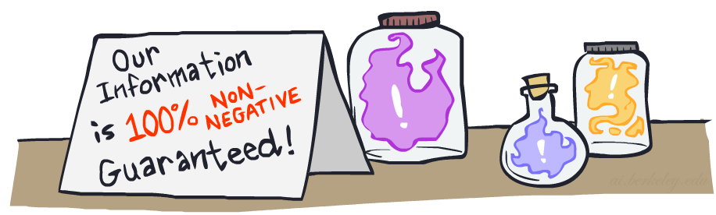
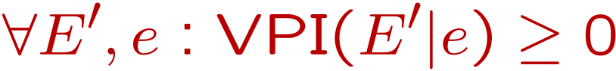
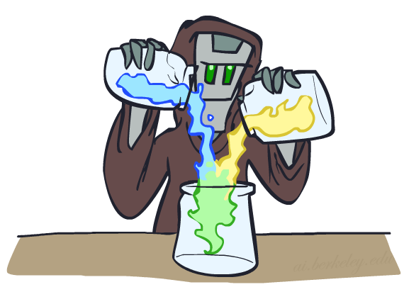
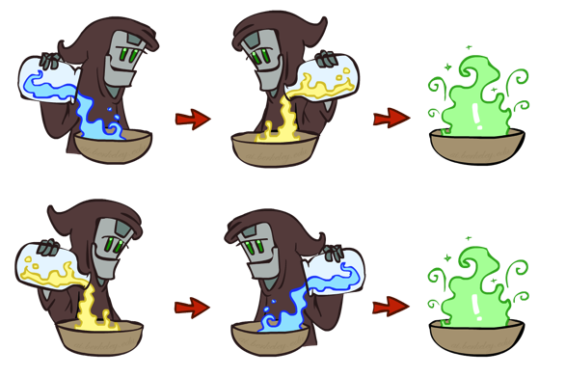
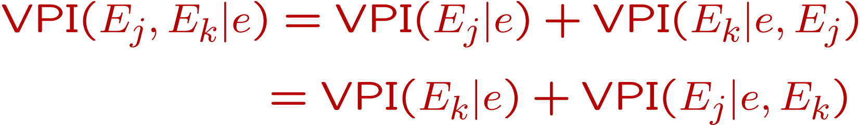
VPI Properties
Nonnegative
Nonadditive
(think of observing E_{j} twice)
Order-independent

Slide 19
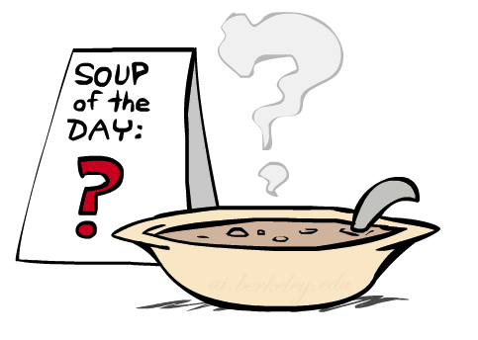
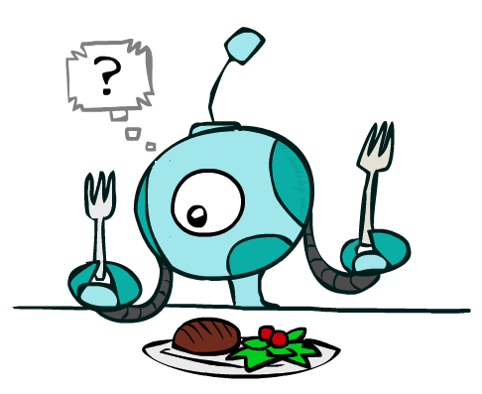
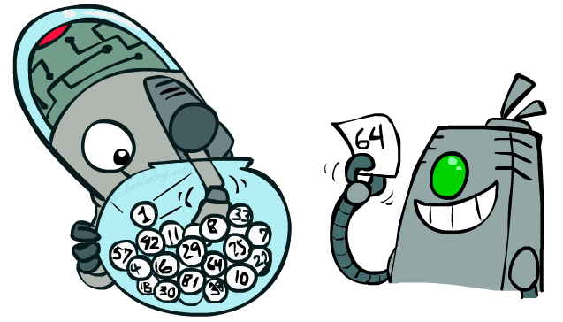
Quick VPI Questions
The soup of the day is either clam chowder or split pea, but you wouldn’t order either one. What’s the value of knowing which it is?
There are two kinds of plastic forks at a picnic. One kind is slightly sturdier. What’s the value of knowing which?
You’re playing the lottery. The prize will be $0 or $100. You can play any number between 1 and 100 (chance of winning is 1%). What is the value of knowing the winning number?

Slide 20
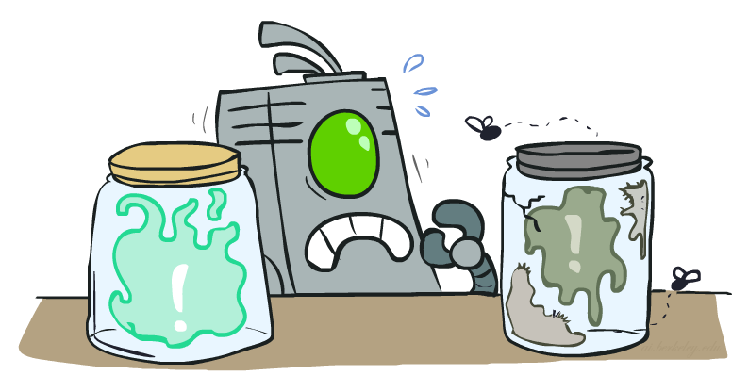
Value of Imperfect Information?
No such thing
Information corresponds to the observation of a node in the decision network
If data is “noisy” that just means we don’t observe the original variable, but another variable which is a noisy version of the original one

Slide 21
VPI Question
VPI(OilLoc) ?
VPI(ScoutingReport) ?
VPI(Scout) ?
VPI(Scout | ScoutingReport) ?
Generally:
If Parents(U) Z | CurrentEvidence
Then VPI( Z | CurrentEvidence) = 0
DrillLoc
U
Scout
OilLoc
Scouting
Report

Slide 22
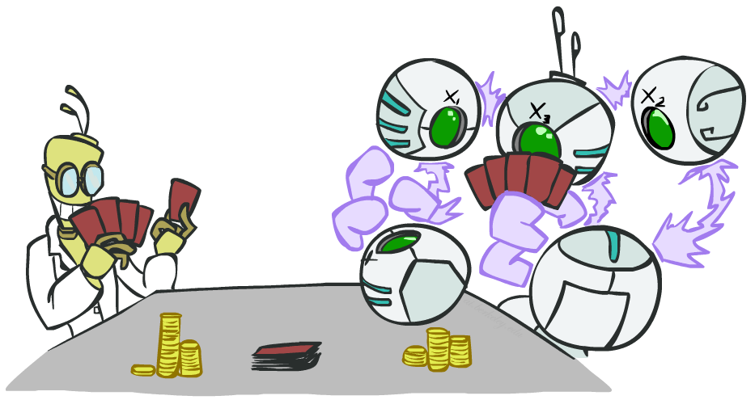
POMDPs

Slide 23
POMDPs
MDPs have:
States S
Actions A
Transition function P(s’|s,a) (or T(s,a,s’))
Rewards R(s,a,s’)
POMDPs add:
Observations O
Observation function P(o|s) (or O(s,o))
POMDPs are MDPs over belief
states b (distributions over S)
We’ll be able to say more in a few lectures
s
a
s, a
s,a,s’
s’
b
a
b, a
o
b’

Slide 24
Example: Ghostbusters
Demo: Ghostbusters with VPI
In (static) Ghostbusters:
Belief state determined by evidence to date {e}
Tree really over evidence sets
Probabilistic reasoning needed to predict new evidence given past evidence
Solving POMDPs
One way: use truncated expectimax to compute approximate value of actions
What if you only considered busting or one sense followed by a bust?
You get a VPI-based agent!
b
{e}
a
a
b, a
e, a
e’
e’
b’
{e, e’}
{e}
a_{bust}
a_{sense}
{e}, a_{sense}
U(a_{bust}, {e})
e’
{e, e’}
a_{bust}
U(a_{bust}, {e, e’})

Slide 25
More Generally*
General solutions map belief functions to actions
Can divide regions of belief space (set of belief functions) into policy regions (gets complex quickly)
Can build approximate policies using discretization methods
Can factor belief functions in various ways
Overall, POMDPs are very (actually PSACE-) hard
Most real problems are POMDPs, but we can rarely solve then in general!

Slide 26
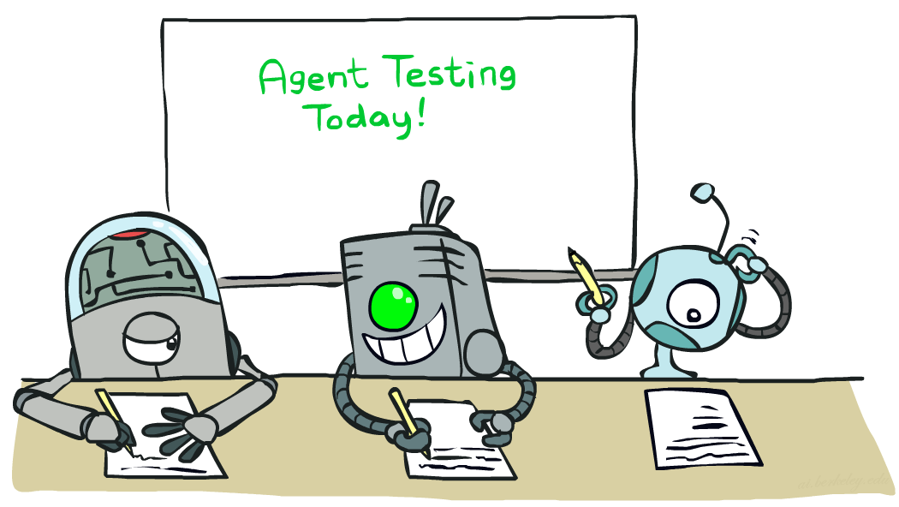

Naïve Bayes
Notes:
Please retain proper attribution, including the reference to ai.berkeley.edu. Thanks!

Slide 27
Machine Learning
Up until now: how use a model to make optimal decisions
Machine learning: how to acquire a model from data / experience
Learning parameters (e.g. probabilities)
Learning structure (e.g. BN graphs)
Learning hidden concepts (e.g. clustering)
Today: model-based classification with Naive Bayes

Slide 28
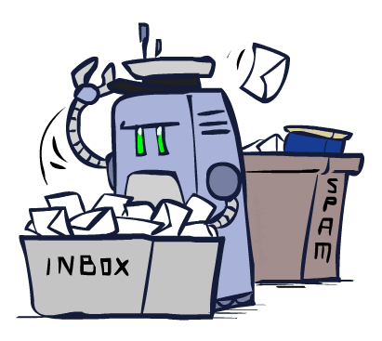
Classification

Slide 29
Example: Spam Filter
Input: an email
Output: spam/ham
Setup:
Get a large collection of example emails, each labeled “spam” or “ham”
Note: someone has to hand label all this data!
Want to learn to predict labels of new, future emails
Features: The attributes used to make the ham / spam decision
Words: FREE!
Text Patterns: $dd, CAPS
Non-text: SenderInContacts
…
Dear Sir.
First, I must solicit your confidence in this transaction, this is by virture of its nature as being utterly confidencial and top secret. …
TO BE REMOVED FROM FUTURE MAILINGS, SIMPLY REPLY TO THIS MESSAGE AND PUT "REMOVE" IN THE SUBJECT.
99 MILLION EMAIL ADDRESSES
FOR ONLY $99
Ok, Iknow this is blatantly OT but I'm beginning to go insane. Had an old Dell Dimension XPS sitting in the corner and decided to put it to use, I know it was working pre being stuck in the corner, but when I plugged it in, hit the power nothing happened.

Slide 30
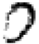
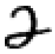

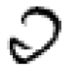
Example: Digit Recognition
Input: images / pixel grids
Output: a digit 0-9
Setup:
Get a large collection of example images, each labeled with a digit
Note: someone has to hand label all this data!
Want to learn to predict labels of new, future digit images
Features: The attributes used to make the digit decision
Pixels: (6,8)=ON
Shape Patterns: NumComponents, AspectRatio, NumLoops
…
0
1
2
1
??

Slide 31
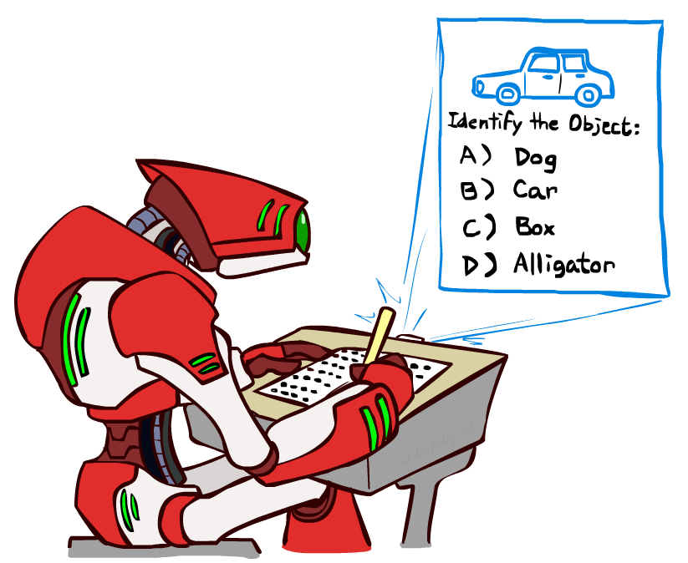
Other Classification Tasks
Classification: given inputs x, predict labels (classes) y
Examples:
Spam detection (input: document,
classes: spam / ham)
OCR (input: images, classes: characters)
Medical diagnosis (input: symptoms,
classes: diseases)
Automatic essay grading (input: document,
classes: grades)
Fraud detection (input: account activity,
classes: fraud / no fraud)
Customer service email routing
… many more
Classification is an important commercial technology!

Slide 32
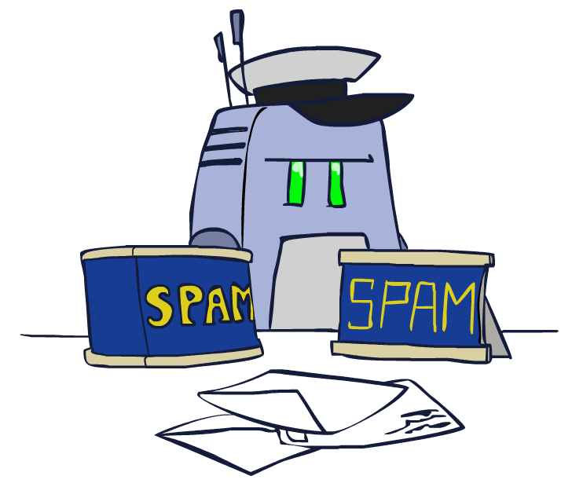
Model-Based Classification

Slide 33
Model-Based Classification
Model-based approach
Build a model (e.g. Bayes’ net) where both the label and features are random variables
Instantiate any observed features
Query for the distribution of the label conditioned on the features
Challenges
What structure should the BN have?
How should we learn its parameters?

Slide 34

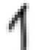
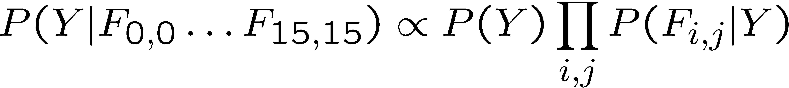
Naïve Bayes for Digits
Naïve Bayes: Assume all features are independent effects of the label
Simple digit recognition version:
One feature (variable) F_{ij} for each grid position <i,j>
Feature values are on / off, based on whether intensity
is more or less than 0.5 in underlying image
Each input maps to a feature vector, e.g.
Here: lots of features, each is binary valued
Naïve Bayes model:
What do we need to learn?
Y
F₁
F₂
F_{n}

Slide 35

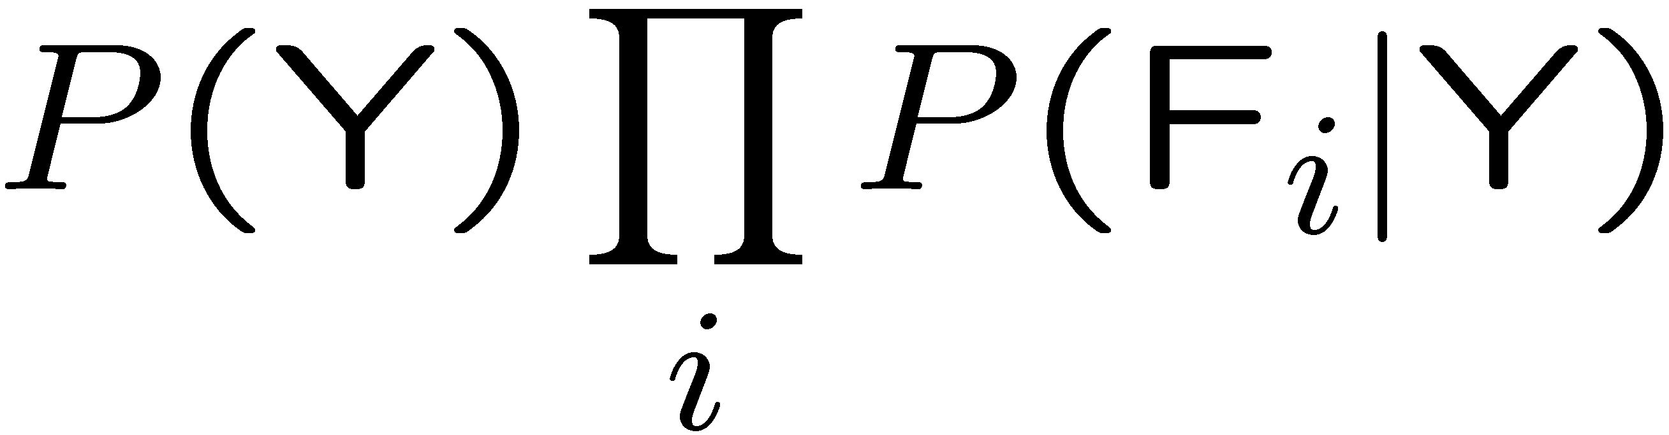
General Naïve Bayes
A general Naive Bayes model:
We only have to specify how each feature depends on the class
Total number of parameters is linear in n
Model is very simplistic, but often works anyway
Y
|Y| parameters
F₁
F₂
F_{n}
|Y| x |F|^{n} values
n x |F| x |Y| parameters

Slide 36
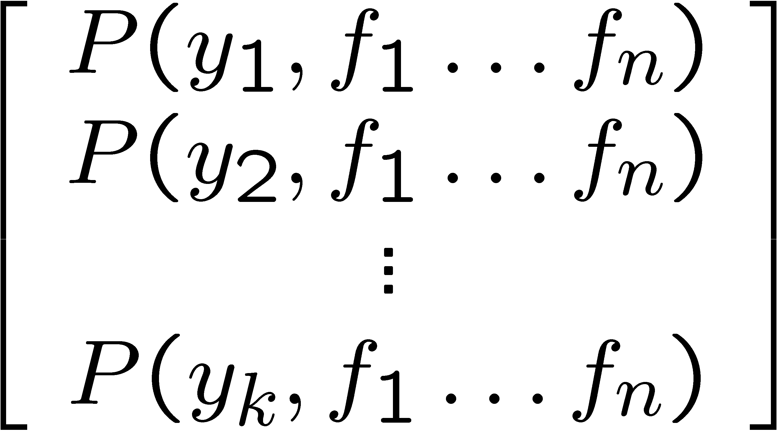
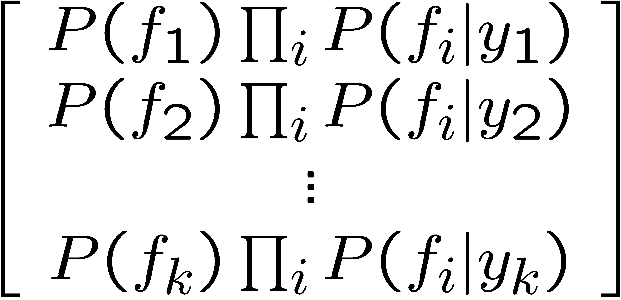

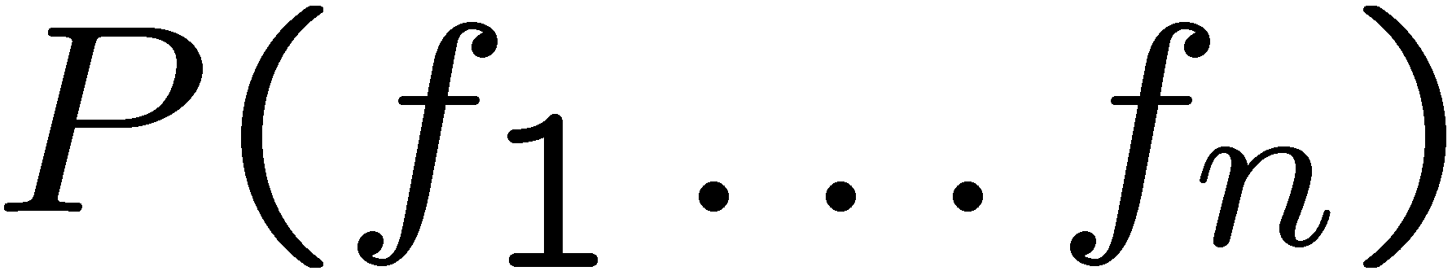
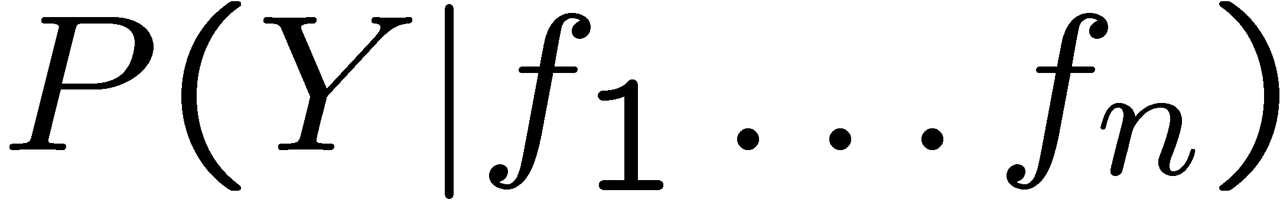
Inference for Naïve Bayes
Goal: compute posterior distribution over label variable Y
Step 1: get joint probability of label and evidence for each label
Step 2: sum to get probability of evidence
Step 3: normalize by dividing Step 1 by Step 2
+

Slide 37
General Naïve Bayes
What do we need in order to use Naïve Bayes?
Inference method (we just saw this part)
Start with a bunch of probabilities: P(Y) and the P(F_{i}|Y) tables
Use standard inference to compute P(Y|F₁…F_{n})
Nothing new here
Estimates of local conditional probability tables
P(Y), the prior over labels
P(F_{i}|Y) for each feature (evidence variable)
These probabilities are collectively called the parameters of the model and denoted by θ
Up until now, we assumed these appeared by magic, but…
…they typically come from training data counts: we’ll look at this soon

Slide 38
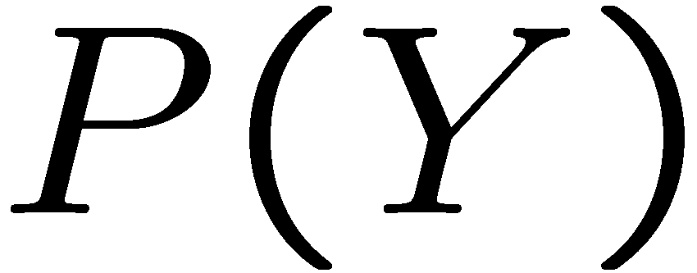


Example: Conditional Probabilities
1 | 0.1
2 | 0.1
3 | 0.1
4 | 0.1
5 | 0.1
6 | 0.1
7 | 0.1
8 | 0.1
9 | 0.1
0 | 0.1
1 | 0.01
2 | 0.05
3 | 0.05
4 | 0.30
5 | 0.80
6 | 0.90
7 | 0.05
8 | 0.60
9 | 0.50
0 | 0.80
1 | 0.05
2 | 0.01
3 | 0.90
4 | 0.80
5 | 0.90
6 | 0.90
7 | 0.25
8 | 0.85
9 | 0.60
0 | 0.80

Slide 39

Naïve Bayes for Text
Bag-of-words Naïve Bayes:
Features: W_{i} is the word at positon i
As before: predict label conditioned on feature variables (spam vs. ham)
As before: assume features are conditionally independent given label
New: each W_{i} is identically distributed
Generative model:
“Tied” distributions and bag-of-words
Usually, each variable gets its own conditional probability distribution P(F|Y)
In a bag-of-words model
Each position is identically distributed
All positions share the same conditional probs P(W|Y)
Why make this assumption?
Called “bag-of-words” because model is insensitive to word order or reordering
Word at position i, not i^{th} word in the dictionary!

Slide 40



Example: Spam Filtering
Model:
What are the parameters?
Where do these tables come from?
ham : 0.66
spam: 0.33
the : 0.0156
to : 0.0153
and : 0.0115
of : 0.0095
you : 0.0093
a : 0.0086
with: 0.0080
from: 0.0075
...
the : 0.0210
to : 0.0133
of : 0.0119
2002: 0.0110
with: 0.0108
from: 0.0107
and : 0.0105
a : 0.0100
...

Slide 41
Spam Example
Word | P(w|spam) | P(w|ham) | Tot Spam | Tot Ham
(prior) | 0.33333 | 0.66666 | -1.1 | -0.4
Gary | 0.00002 | 0.00021 | -11.8 | -8.9
would | 0.00069 | 0.00084 | -19.1 | -16.0
you | 0.00881 | 0.00304 | -23.8 | -21.8
like | 0.00086 | 0.00083 | -30.9 | -28.9
to | 0.01517 | 0.01339 | -35.1 | -33.2
lose | 0.00008 | 0.00002 | -44.5 | -44.0
weight | 0.00016 | 0.00002 | -53.3 | -55.0
while | 0.00027 | 0.00027 | -61.5 | -63.2
you | 0.00881 | 0.00304 | -66.2 | -69.0
sleep | 0.00006 | 0.00001 | -76.0 | -80.5
P(spam | w) = 98.9

Slide 42



Training and Testing

Slide 43



Important Concepts
Data: labeled instances, e.g. emails marked spam/ham
Training set
Held out set
Test set
Features: attribute-value pairs which characterize each x
Experimentation cycle
Learn parameters (e.g. model probabilities) on training set
(Tune hyperparameters on held-out set)
Compute accuracy of test set
Very important: never “peek” at the test set!
Evaluation
Accuracy: fraction of instances predicted correctly
Overfitting and generalization
Want a classifier which does well on test data
Overfitting: fitting the training data very closely, but not generalizing well
We’ll investigate overfitting and generalization formally in a few lectures
Training
Data
Held-Out
Data
Test
Data

Slide 44


Slide 45


Slide 46



Generalization and Overfitting

Slide 47
Overfitting
30
25
20
Degree 15 polynomial
15
10
5
0
-5
-10
-15
0
2
4
6
8
10
12
14
16
18
20

Slide 48












Example: Overfitting
2 wins!!

Slide 49


Example: Overfitting
Posteriors determined by relative probabilities (odds ratios):
south-west : inf
nation : inf
morally : inf
nicely : inf
extent : inf
seriously : inf
...
screens : inf
minute : inf
guaranteed : inf
$205.00 : inf
delivery : inf
signature : inf
...
What went wrong here?

Slide 50
Generalization and Overfitting
Relative frequency parameters will overfit the training data!
Just because we never saw a 3 with pixel (15,15) on during training doesn’t mean we won’t see it at test time
Unlikely that every occurrence of “minute” is 100% spam
Unlikely that every occurrence of “seriously” is 100% ham
What about all the words that don’t occur in the training set at all?
In general, we can’t go around giving unseen events zero probability
As an extreme case, imagine using the entire email as the only feature
Would get the training data perfect (if deterministic labeling)
Wouldn’t generalize at all
Just making the bag-of-words assumption gives us some generalization, but isn’t enough
To generalize better: we need to smooth or regularize the estimates

Slide 51

Parameter Estimation

Slide 52




Parameter Estimation
Estimating the distribution of a random variable
Elicitation: ask a human (why is this hard?)
Empirically: use training data (learning!)
E.g.: for each outcome x, look at the empirical rate of that value:
This is the estimate that maximizes the likelihood of the data
r
b
b
b
r
r
b
b
b
r
r
b
b
b
b
r
r
b

Slide 53

Smoothing

Slide 54





Maximum Likelihood?
Relative frequencies are the maximum likelihood estimates
Another option is to consider the most likely parameter value given the data
????

Slide 55


Unseen Events

Slide 56




Laplace Smoothing
Laplace’s estimate:
Pretend you saw every outcome once more than you actually did
Can derive this estimate with Dirichlet priors (see cs281a)
r
r
b

Slide 57





Laplace Smoothing
Laplace’s estimate (extended):
Pretend you saw every outcome k extra times
What’s Laplace with k = 0?
k is the strength of the prior
Laplace for conditionals:
Smooth each condition independently:
r
r
b

Slide 58
Estimation: Linear Interpolation*
In practice, Laplace often performs poorly for P(X|Y):
When |X| is very large
When |Y| is very large
Another option: linear interpolation
Also get the empirical P(X) from the data
Make sure the estimate of P(X|Y) isn’t too different from the empirical P(X)
What if α is 0? 1?
For even better ways to estimate parameters, as well as details of the math, see cs281a, cs288

Slide 59
Real NB: Smoothing
For real classification problems, smoothing is critical
New odds ratios:
helvetica : 11.4
seems : 10.8
group : 10.2
ago : 8.4
areas : 8.3
...
verdana : 28.8
Credit : 28.4
ORDER : 27.2
<FONT> : 26.9
money : 26.5
...
Do these make more sense?

Slide 60

Tuning

Slide 61








Tuning on Held-Out Data
Now we’ve got two kinds of unknowns
Parameters: the probabilities P(X|Y), P(Y)
Hyperparameters: e.g. the amount / type of smoothing to do, k, α
What should we learn where?
Learn parameters from training data
Tune hyperparameters on different data
Why?
For each value of the hyperparameters, train and test on the held-out data
Choose the best value and do a final test on the test data

Slide 62

Features

Slide 63
Errors, and What to Do
Examples of errors
Dear GlobalSCAPE Customer,
GlobalSCAPE has partnered with ScanSoft to offer you the latest version of OmniPage Pro, for just $99.99* - the regular list price is $499! The most common question we've received about this offer is - Is this genuine? We would like to assure you that this offer is authorized by ScanSoft, is genuine and valid. You can get the . . .
. . . To receive your $30 Amazon.com promotional certificate, click through to
http://www.amazon.com/apparel
and see the prominent link for the $30 offer. All details are there. We hope you enjoyed receiving this message. However, if you'd rather not receive future e-mails announcing new store launches, please click . . .

Slide 64

What to Do About Errors?
Need more features– words aren’t enough!
Have you emailed the sender before?
Have 1K other people just gotten the same email?
Is the sending information consistent?
Is the email in ALL CAPS?
Do inline URLs point where they say they point?
Does the email address you by (your) name?
Can add these information sources as new variables in the NB model
Next class we’ll talk about classifiers which let you easily add arbitrary features more easily

Slide 65
Baselines
First step: get a baseline
Baselines are very simple “straw man” procedures
Help determine how hard the task is
Help know what a “good” accuracy is
Weak baseline: most frequent label classifier
Gives all test instances whatever label was most common in the training set
E.g. for spam filtering, might label everything as ham
Accuracy might be very high if the problem is skewed
E.g. calling everything “ham” gets 66%, so a classifier that gets 70% isn’t very good…
For real research, usually use previous work as a (strong) baseline

Slide 66


Confidences from a Classifier
The confidence of a probabilistic classifier:
Posterior over the top label
Represents how sure the classifier is of the classification
Any probabilistic model will have confidences
No guarantee confidence is correct
Calibration
Weak calibration: higher confidences mean higher accuracy
Strong calibration: confidence predicts accuracy rate
What’s the value of calibration?

Slide 67
Summary
Bayes rule lets us do diagnostic queries with causal probabilities
The naïve Bayes assumption takes all features to be independent given the class label
We can build classifiers out of a naïve Bayes model using training data
Smoothing estimates is important in real systems
Classifier confidences are useful, when you can get them

